Slide 1
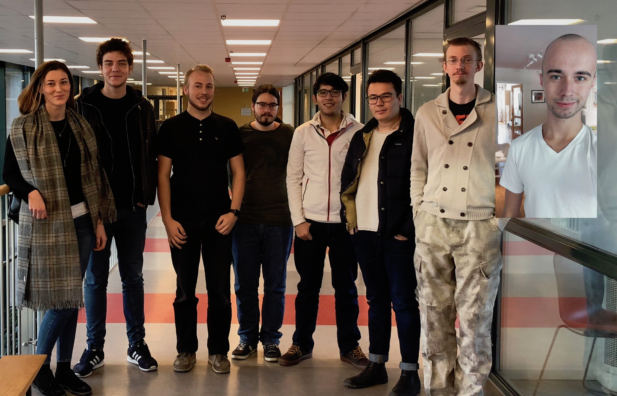
Group 1
INTERACTIVE JOINT KANBAN BOARD FOR ABB PORTS

Slide 2
Group members
André Caldegren
Anton Roslund – Project Manager / Client Communication
Amer Surkovic – Configuration Management
Dzana Hanic
Jawid Nasiri
Kevin Oswaldo Cabrera Navarro
Noah Gustavsson
Robert Duras

Slide 3
Client
ABB Ports
Christoffer Holmstedt
christoffer.holmstedt@se.abb.com
021-32 46 18

Slide 4
The Project
A Kanban board for visual representation of ”artifacts” on their TeamForge server

Slide 5
So far
Basic team organization
Meeting with client
Set up of team technologies
Facebook messenger group - possibly already deprecated in favor of slack
Slack for primary means of communication.
GitHub for storing our code
GitHub project for group Kanban board
GitHub wiki for documentation and planning around the project.
Google calendar for group meetings and calendar stuff.

Slide 6
So far
We have started
Project Plan
Requirements
Use case diagrams
Contacted collabnet for access to TeamForge
Forming questions for the client

Slide 7
The activities planned for the rest of the week
Plan the next week
Continue working with the project plan
Work on the use case diagram
Initial design sketches

Slide 8
Any obstacles, risks or issues that have been identified
No access to TeamForge. Still unable to to get a free trial, waiting on response from Collabnet
TeamForge’s free trial is limited to 30 days
Overlapping schedules

Slide 9
Questions to the steering group, if any
Are we required present any diagrams to the steering group?
Could the school pay for TeamForge? It’s 420$ for 10 users/year
What does the proposed role “Document Tem”

